Slide 1

Composite-Based SEM
Chapter 11: Analyzing Interaction Effects

Slide 2
Topics
The logic of interaction
Estimating interaction effects with composite-based SEM
Multigroup analysis
The two-stage approach
The orthogonalizing approach
Visualizing interaction effects
Surface analysis
Spotlight analysis
Floodlight analysis
Three-way interactions
Outlook: Nonlinear effects

Slide 3
What is a Moderator?
“In general terms, a moderator is a qualitative (e.g., sex, race, class) or quantitative (e.g., level of reward) variable that affects the direction and/or strength of the relation between an independent or predictor variable and a dependent or criterion variable.”
(Baron & Kenny 1986, p. 1174)

Slide 4
An Example of Moderation

Slide 5
Analyzing Interaction Effects by Means of Multigroup Analysis
Split sample into two (or more) subsamples (categories).
Categorize observations according to the level of the moderator variable.
Estimate the path coefficients for each subsample.
Interpret differences between path coefficients as moderating effects.

Slide 6
Analyzing Interaction Effects by Means of Multigroup Analysis
Observations with moderator variable being high:
Observations with moderator variable being low:
Moderating effect:

Slide 7
Discussion on Group Comparisons
Adequate for dichotomous moderating variables and/or experimental designs (Bagozzi, Yi & Singh, 1991).
For continuous variables:
Dichotomization or data splitting required:
Median split or
Forming three groups, ignoring middle third
Problems interpreting the results:
Dichotomization is arbitrary.
Within-group variance remains unanalyzed.
Rather a quick check.

Slide 8
Minimal Model

Slide 9
Alternative Representation

Slide 10
The Meaning of Path Coefficients Changes
The path coefficients between latent variables do no longer represent main effects but so-called "single effects".
Single effects can differ (also strongly) in magnitude from the corresponding main effects.
A single effect expresses the strength of an effect when the moderator variable is zero.
It is indispensable to include all single effects in the model.

Slide 11
The Two-Stage Approach for Analyzing Interaction Effects
Stage 1: Estimating the main effects model (without the interaction).
Obtain construct scores / construct scores correlation matrix
Obtain reliabilities of construct scores
Stage 2: Estimating the full model (including the interaction).
Use construct scores as indicators.
Devise reliabilities.
Create interaction term.

Slide 12
The Orthogonalizing Approach
Applicable to interactions of latent variables
Regress product indicators on the indicators of the independent and the moderator variable:
Use the residuals as indicators of the interaction term!
Advantage: Single effects are very similar to main effects.

Slide 13
The Orthogonalizing Approach
Little, Bovaird & Widaman, 2006; Chin & Henseler, 2010)
orthogonalized product indicators

Slide 14
Quantifying Interaction Effects
Effect size:
Effect sizes of 0.02/0.15/0.35 are regarded as weak/moderate/strong (Cohen 1988).
“Even a small interaction effect can be meaningful under extreme moderating conditions, if the resulting beta changes are meaningful, then it is important to take these conditions into account” (Chin, Marcolin & Newsted 2003, p. 211).

Slide 15
Visualizing Interaction Effects

Slide 16
Visualizing Interaction Effects

Slide 17
Visualizing Interaction Effects

Slide 18
A Three-Way Interaction

Slide 19
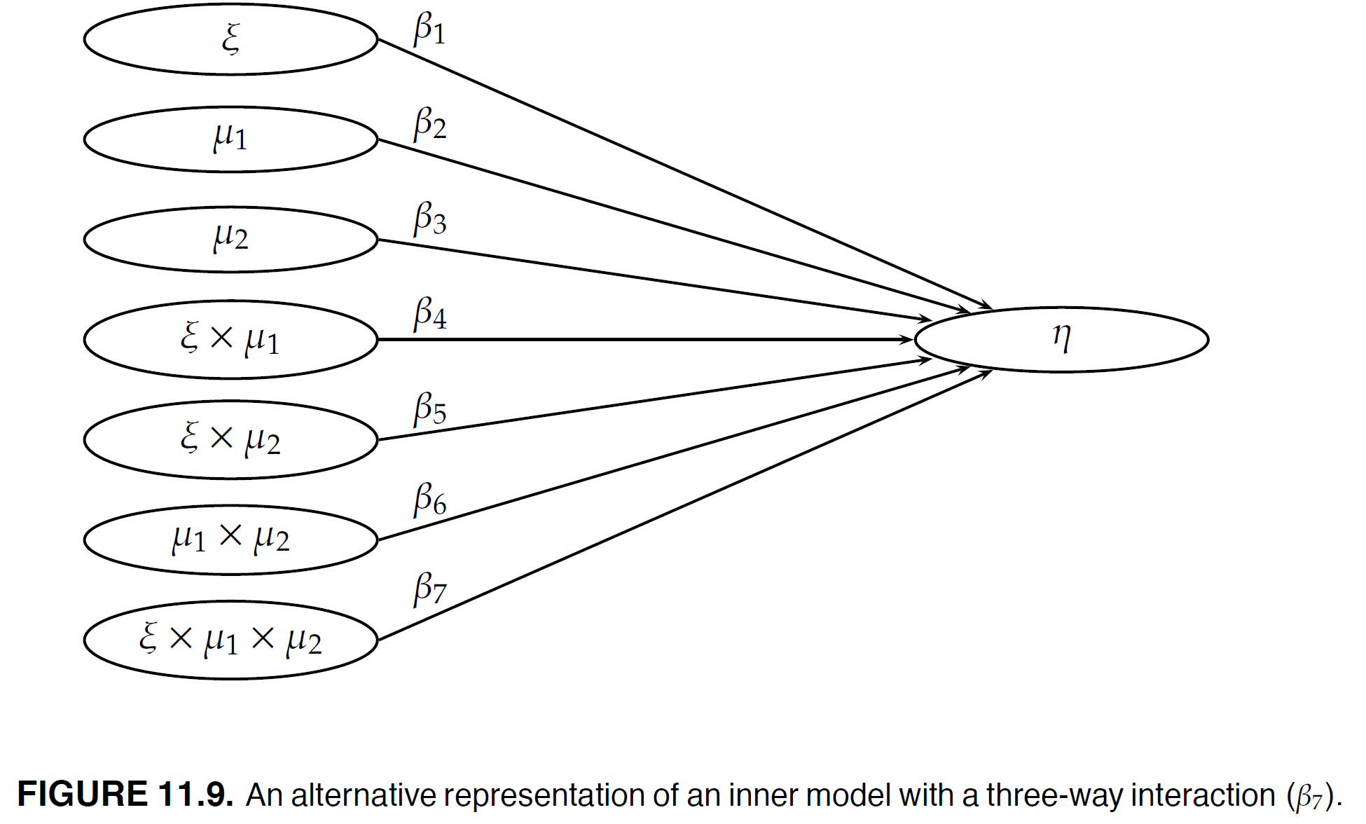
Alternative Representation

Slide 20
Discussion on Three-Way Interactions
Three-way interactions are difficult to interpret and explain to readers (“μ2 influences the strength of μ1’s effect on the effect of ξ on η”).
A model containing three-way interactions does not tend to be parsimonious.
Some editors / reviewers / readers love three-way interactions (and some don’t).

Slide 21
Quadratic Effects
Quadratic effects can be interpreted as „auto-moderation“, i.e., an independent variable moderates its own effect.

Slide 22
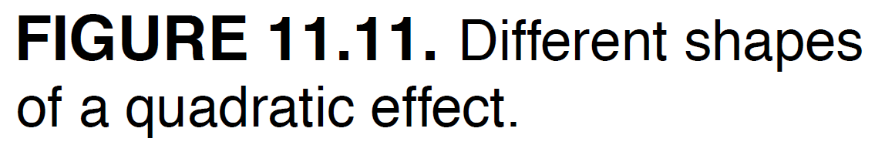
The Different Shapes of a Quadratic Effect

Slide 23
Bibliography
Bagozzi, R. P., Yi, Y., & Singh, S. (1991). On the use of structural equation models in experimental designs: Two extensions. International Journal of Research in Marketing, 8(2), 125–140.
Baron, R.M., & Kenny, D. A. (1986). The moderator-mediator variable distinction in social psychological research: Conceptual, strategic, and statistical considerations. Journal of Personality and Social Psychology, 51(6), 1173–1182.
Chin, W. W., Marcolin, B. L., & Newsted, P. R. (2003). A partial least squares latent variable modeling approach for measuring interaction effects: Results from a Monte Carlo simulation study and an electronic-mail emotion/adoption study. Information Systems Research, 14(2), 189–217.
Cohen, J. (1988). Statistical Power Analysis for the Behavioral Sciences. Mahwah, NJ: Erlbaum.
Henseler, J. (2020). Composite-Based Structural Equation Modeling: Analyzing Latent and Emergent Variables, New York: Guilford Press.
Henseler, J., & Chin, W.W. (2010). A comparison of approaches for the analysis of interaction effects between latent variables using partial least squares path modeling. Structural Equation Modeling: A Multidisciplinary Journal, 17(1), 82–109.
Little, T. D., Bovaird, J. A., & Widaman, K. F. (2006). On the merits of orthogonalizing powered and product terms: Implications for modeling interactions among latent variables. Structural Equation Modeling, 13(4), 497–519.

