Slide 1

Composite-Based SEM
Chapter 10: Second-Order Constructs

Slide 2
Topics
The nature of second-order constructs
A typology of second-order constructs
Modeling second-order constructs
Type I: Latent variables measured by latent variables
Type II: Emergent variables made of latent variables
Type III: Latent variables measured by emergent variables
Type IV: Emergent variables made of emergent variables
Type V: Latent variables measured by different types of variables
Type VI: Emergent variables made of different types of variables

Slide 3
Second-Order Constructs
Constructs whose indicators are not directly observable but again modeled through constructs.
Higher level of abstraction.
Constructs of an even higher order are conceivable, too (see, for instance, Ulaga & Eggert, 2006, for an example of a fourth-order construct)
Mainly a subject of confirmatory research.
Covariance-based SEM is recommended.

Slide 4
A Typology of Second-Order Constructs

Slide 5
Specifying Type-I Second-Order Constructs
Note:
There is no known approach of how to specify Type-I second-order constructs in variance-based SEM.

Slide 6
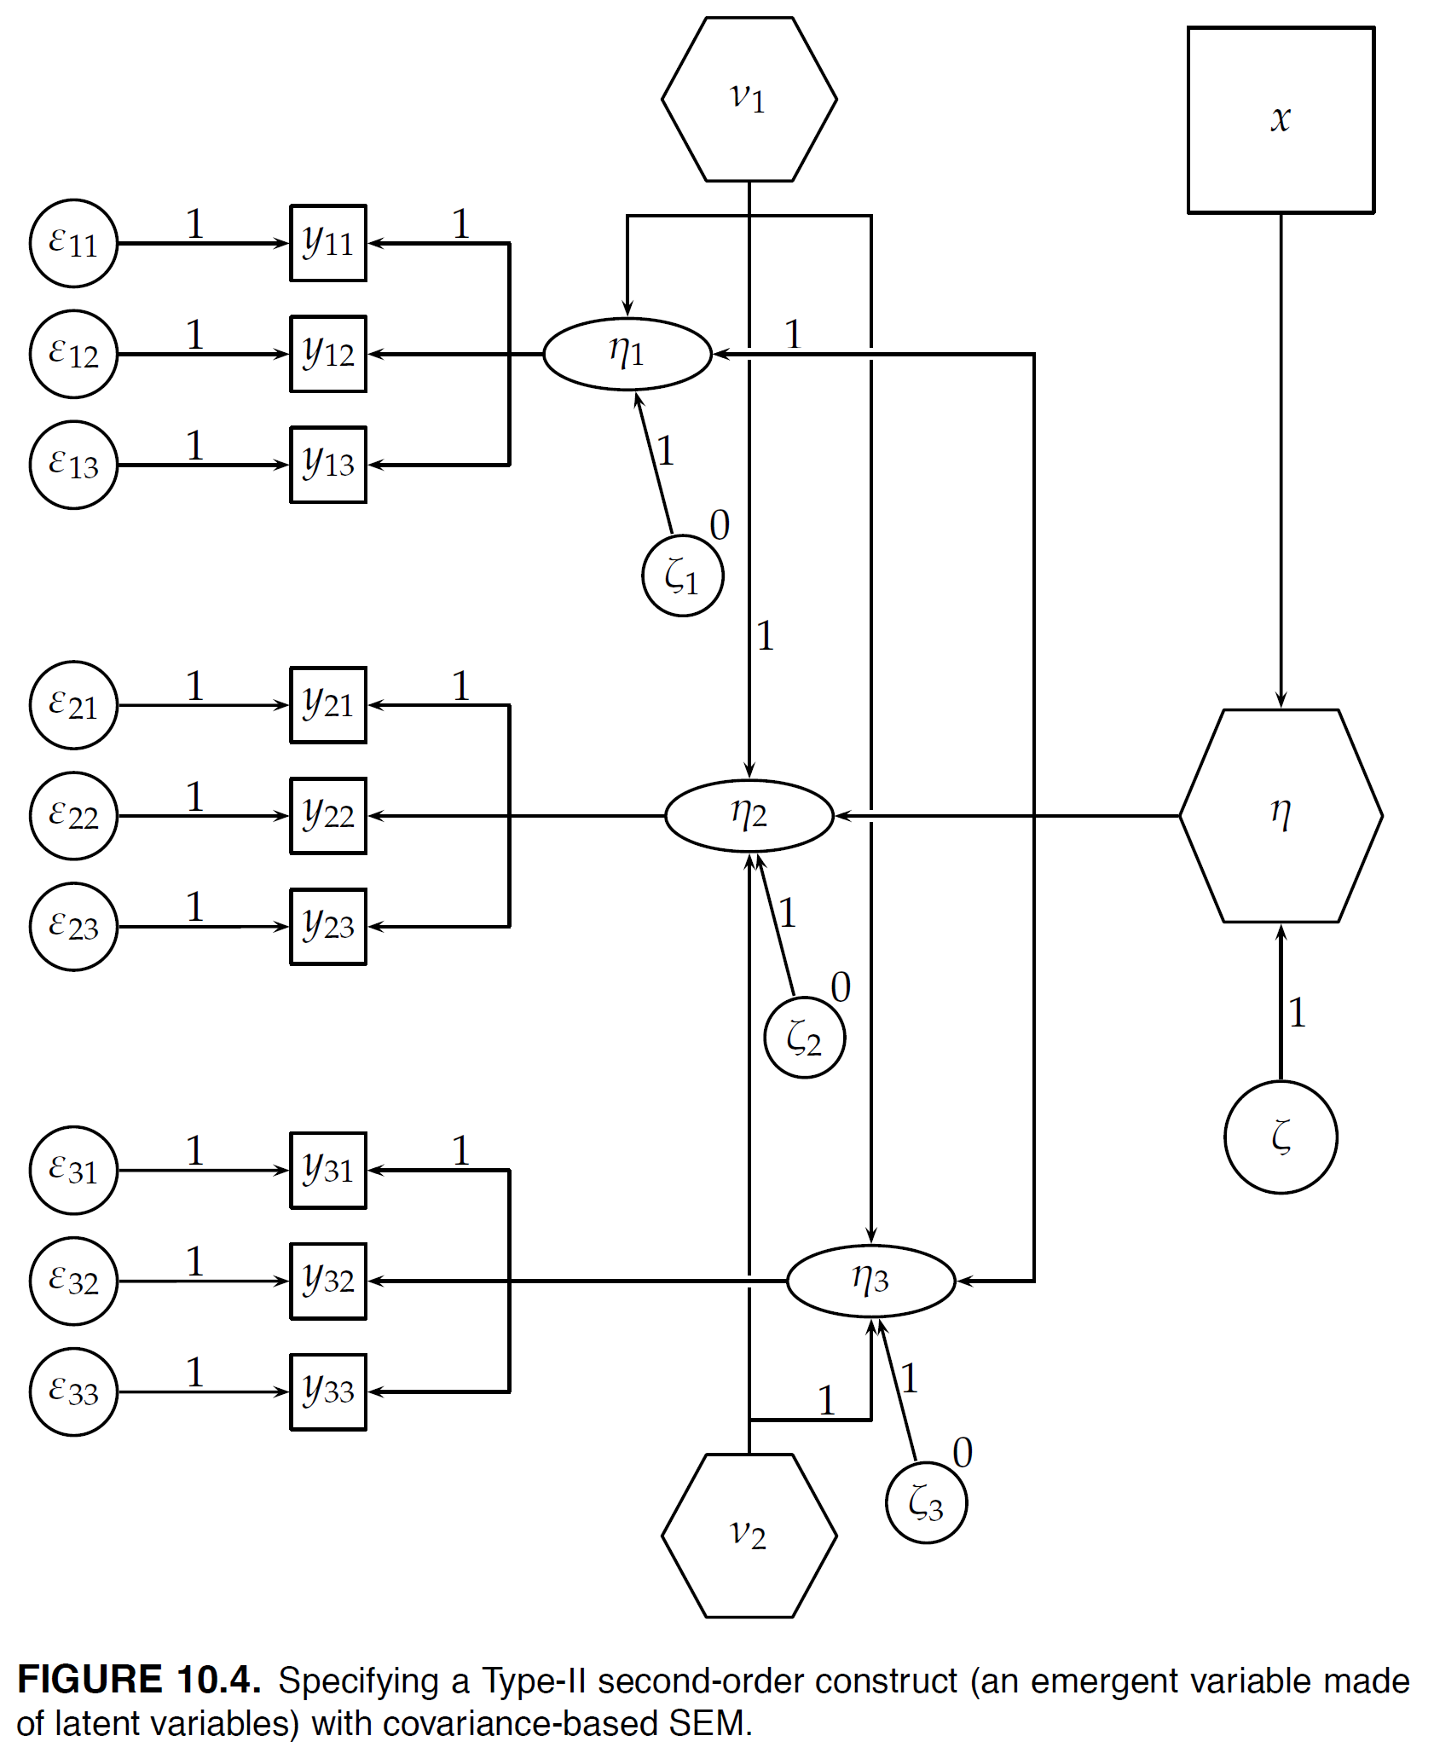
Specifying Type-II Second-Order Constructs
Note:
x is some other variable in the nomological net of η.

Slide 7
Type-II Second-Order Constructs in Variance-Based SEM

Slide 8
Specifying Type-III Second-Order Constructs

Slide 9
Type-III Second-Order Constructs in Variance-Based SEM

Slide 10
Specifying Type-IV Second-Order Constructs
Note:
x is some other variable in the nomological net of η.

Slide 11
Type-IV Second-Order Constructs in Variance-Based SEM
Note:
See Schuberth, Rademaker & Henseler (forthcoming) for details.

Slide 12
Specifying Type-V Second-Order Constructs

Slide 13
Specifying Type-VI Second-Order Constructs
Note:
x is some other variable in the nomological net of η.

Slide 14
Bibliography
Henseler, J. (2020). Composite-Based Structural Equation Modeling: Analyzing Latent and Emergent Variables, New York: Guilford Press.
Schuberth, F., Rademaker, M. E., & Henseler, J. (forthcoming). Estimating and assessing second-order constructs using PLS-PM: The case of composites of composites. Industrial Management & Data Systems, in print.
Ulaga, W., & Eggert, A. (2006). Value-based differentiation in business relationships: Gaining and sustaining key supplier status. Journal of Marketing, 70(1), 119–136.
van Riel, A. C., Henseler, J., Kemény, I., & Sasovova, Z. (2017). Estimating hierarchical constructs using consistent partial least squares: The case of second-order composites of common factors. Industrial Management & Data Systems, 117(3), 459–477.

