Slide 1
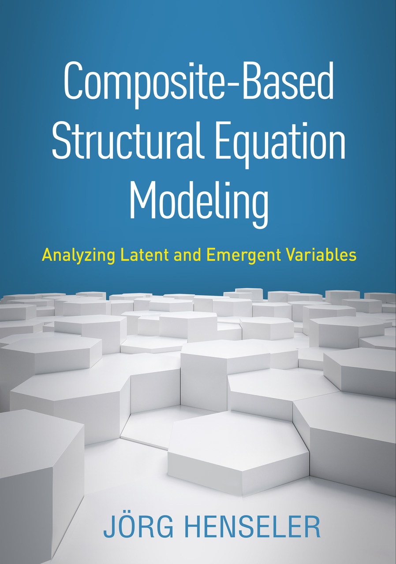
Composite-Based SEM
Chapter 9: Mediation Analysis

Slide 2
Topics
The need for mediation analysis
Practicing mediation analysis

Slide 3
Example
Relationship between sea temperature and number of incidents at a Californian beach.
sea temperature
# of incidents
+
Conclusion 1: Swimming in warm water is more dangerous than swimming in cold water.
Notes:
Although statistical analysis points to a positive effect, the conclusion is nonsense. But why?

Slide 4
Example (cont‘d)
Revised relationship between sea temperature and number of incidents at a Californian beach.
sea temperature
# of swimmers
# of incidents
+
+
+
Conclusion 2: The warmer the water, the more swimmers. The more swimmers, the more incidents.

Slide 5
The Smallest Possible Model with Mediation

Slide 6
Classifying Mediation
Is a×b significant ?
Yes
No
Zhao, Lynch & Chen (2010)
Is c significant ?
Is c significant ?
Yes
No
Yes
No
Is a×b×c positive ?
Yes
No
Complementary (Partial mediation)
Competitive (Partial mediation)
Indirect-only (Full mediation)
Direct-only (No mediation)
No effect (No mediation)

Slide 7
Testing the Indirect Effect
Hypothesis:
Parametric tests of the indirect effect fail to account for the fact that if a and b are normally distributed, the indirect effect cannot be normally distributed as well.
Solution (Preacher & Hayes, 2008): Bootstrap the indirect effect!

Slide 8
Possible Mediation Patterns

Slide 9
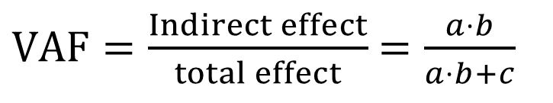
Determining the Relative Size of Complementary Mediating Effects
Variance Accounted For (Shrout & Bolger, 2002):
The VAF can become negative.
Interpretation as suppressor effects
Set to one.
The VAF actually only makes sense for complementary mediation.
$VAF=\frac{Indirect effect}{total effect}$ $=\frac{a⋅b}{a⋅b+c}$

Slide 10
Bibliography
Henseler, J. (2020). Composite-Based Structural Equation Modeling: Analyzing Latent and Emergent Variables, New York: Guilford Press.
Preacher, K. J., & Hayes, A. F. (2008). Contemporary approaches to assessing mediation in communication research. In A. F. Hayes, M. D. Slater, & L. B. Snyder (Eds.), The Sage Sourcebook of Advanced Data Analysis Methods for Communication Research. Thousand Oaks, CA: Sage, pp. 13–54.
Shrout, P. E., & Bolger, N. (2002). Mediation in experimental and nonexperimental studies: New procedures and recommendations. Psychological Methods, 7(4), 422–445
Zhao, X., Lynch, J. G., & Chen, Q. (2010). Reconsidering Baron and Kenny: Myths and truths about mediation analysis. Journal of Consumer Research, 37(2), 197–206.

