Slide 1
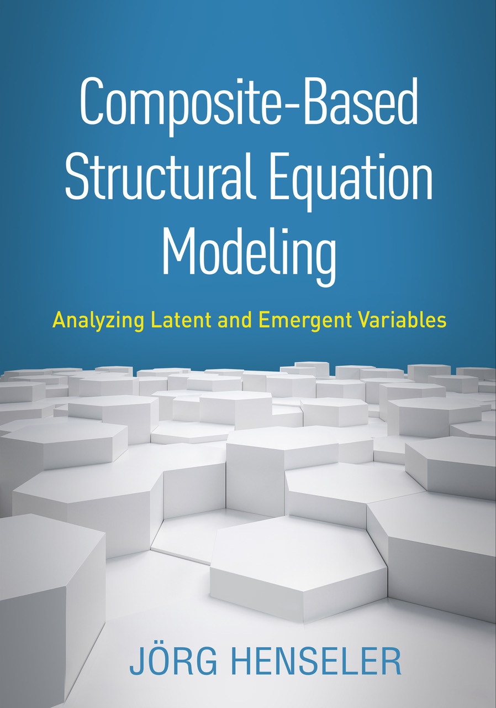
Composite-Based SEM
Chapter 7: Local Model Assessment

Slide 2
Topics
Estimating composite models
Sum Scores
Partial least squares path modeling (PLS)
Generalized canonical correlation analysis (GCCA)
Generalized structured component analysis (GSCA)
Modifications for factor models
Sum scores with correction for attenuation
Consistent PLS (PLSc)
Fitting functions

Slide 3
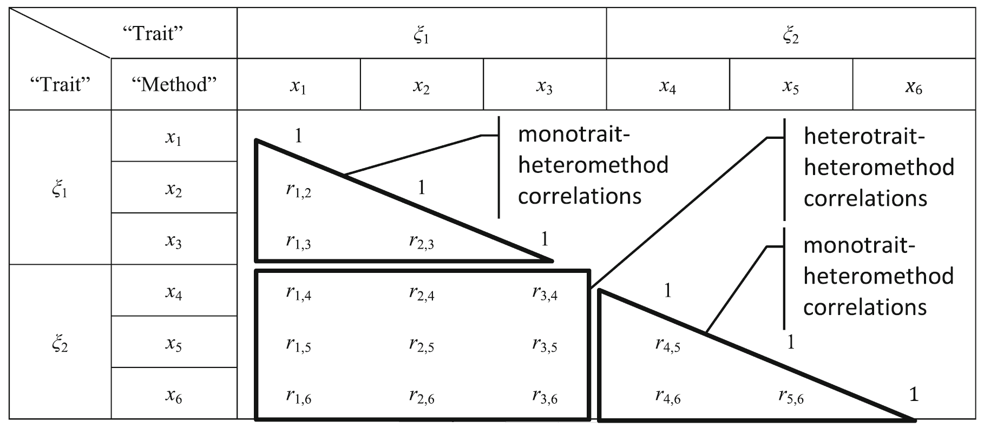
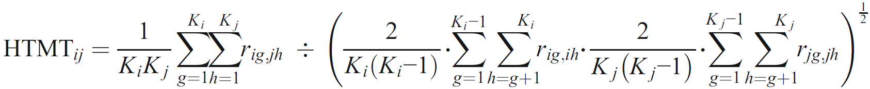
The Heterotrait–Monotrait Ratio of Correlations (HTMT)
(Henseler, Ringle & Sarstedt, 2015)

Slide 4
The Heterotrait–Monotrait Ratio of Correlations (HTMT)
A latent variable should explain better the variance of its own indicators than the variance of other latent variables.
Consequently, a construct’s indicators should correlate more highly with each other than with the indicators of other constructs.
Realization: Heterotrait–monotrait ratio of correlations (HTMT)
Thresholds:
HTMT_{.85}: HTMT < 0.85
HTMT_{.90}: HTMT < 0.90
HTMT_{inference}: HTMT < 1.00 (significantly)

Slide 5
Bibliography
Henseler, J. (2020). Composite-Based Structural Equation Modeling: Analyzing Latent and Emergent Variables, New York: Guilford Press.
Henseler, J., Ringle, C. M., & Sarstedt, M. (2015). A new criterion for assessing discriminant validity in variance-based structural equation modeling. Journal of the Academy of Marketing Science, 43(1), 115–135.

