Slide 1

Composite-Based SEM
Chapter 6: Global Model Assessment

Slide 2
Topics
Estimating composite models
Sum Scores
Partial least squares path modeling (PLS)
Generalized canonical correlation analysis (GCCA)
Generalized structured component analysis (GSCA)
Modifications for factor models
Sum scores with correction for attenuation
Consistent PLS (PLSc)
Fitting functions

Slide 3
Exposing a Model to Reality

Slide 4

Empirical Variance-Covariance Matrix of Observed Variables
The population variance-covariance matrix of observed variables $Σ$ is typically not available.
Instead, we need to rely on the empirical variance-covariance matrix of observed variables, $S$.

Slide 5
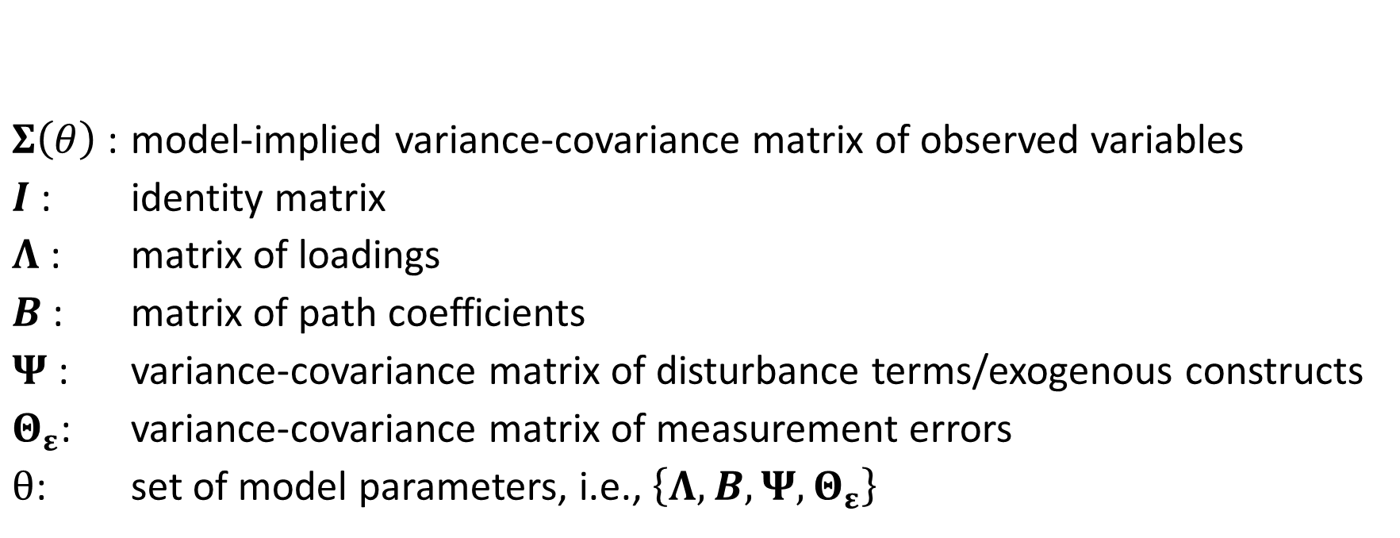
Model-Implied Variance-Covariance Matrix of Observed Variables
$$Σ\left(θ\right)=Λ{\left(I−B\right)}^{−1} Ψ{\left(I−B′\right)}^{−1}Λ^{′}+Θ_{ε}$$
$Σ\left(θ\right)$: model-implied variance-covariance matrix of observed variables
$I$: identity matrix
$Λ$: matrix of loadings
$B$: matrix of path coefficients
$Ψ$: variance-covariance matrix of disturbance terms/exogenous constructs
$Θ_{ε}$: variance-covariance matrix of measurement errors
$θ$: set of model parameters, i.e., $\left\{Λ, B, Ψ, Θ_{ε}\right\}$

Slide 6
The Bollen–Stine Bootstrap: HI95 and HI99

Slide 7
Model Fit Test in ADANCO
The estimated model is the model as specified by the analyst.
The saturated model allows all constructs to freely covary, i.e., it ignores possible constraints imposed by the inner model.

Slide 8
Two Different Understandings of "Fit"
Example: A theory states that two variables are unrelated. We empirically test the theory.
Results from Correlation or Regression: R² = 0 Thus, no fit!
Results from SEM: Σ = S Thus, perfect fit!

Slide 9
Strictly Confirmatory Theory Testing
In a strictly confirmatory situation, the researcher has formulated one single model and has obtained empirical data to test it. The model should be either accepted or rejected.
The model is supported if its implied covariance-matrix does not differ significantly from the empirical covariance matrix.
Product attributes
Affect
Behavior
Consumer characteristics

Slide 10
Theory Testing: Alternative Models
The researcher has specified several alternative models (or competing models) and, on the basis of an analysis of a single set of empirical data, one of the models should be selected.
Model 1 is supported if its fit is not significantly worse.
Model 1
Product attributes
Model 2
Product attributes
Affect
Behavior
Affect
Behavior
Consumer characteristics
Consumer characteristics

Slide 11
Theory Testing: Model Generating
The researcher has specified a tentative initial model. If the initial model does not fit the given data, the model should be modified and tested again using the same data. Several models can be tested.
Finding of a model that fits the data well from a statistical point of view and additionally every parameter of the model can be given a substantively meaningful interpretation.
The re-specification of each model may be theory driven or data driven. Although a model may be tested in each round, the whole approach is model generating, rather than model testing. Depending on the circumstances, the chances to identify the true model can be quite small (MacCallum 1986).
Product attributes
Affect
Behavior
Consumer characteristics

Slide 12
Bibliography
Henseler, J. (2020). Composite-Based Structural Equation Modeling: Analyzing Latent and Emergent Variables, New York: Guilford Press.
MacCallum, R. (1986). Specification searches in covariance structure modeling. Psychological Bulletin, 100(1), 107–120.

