Slide 1
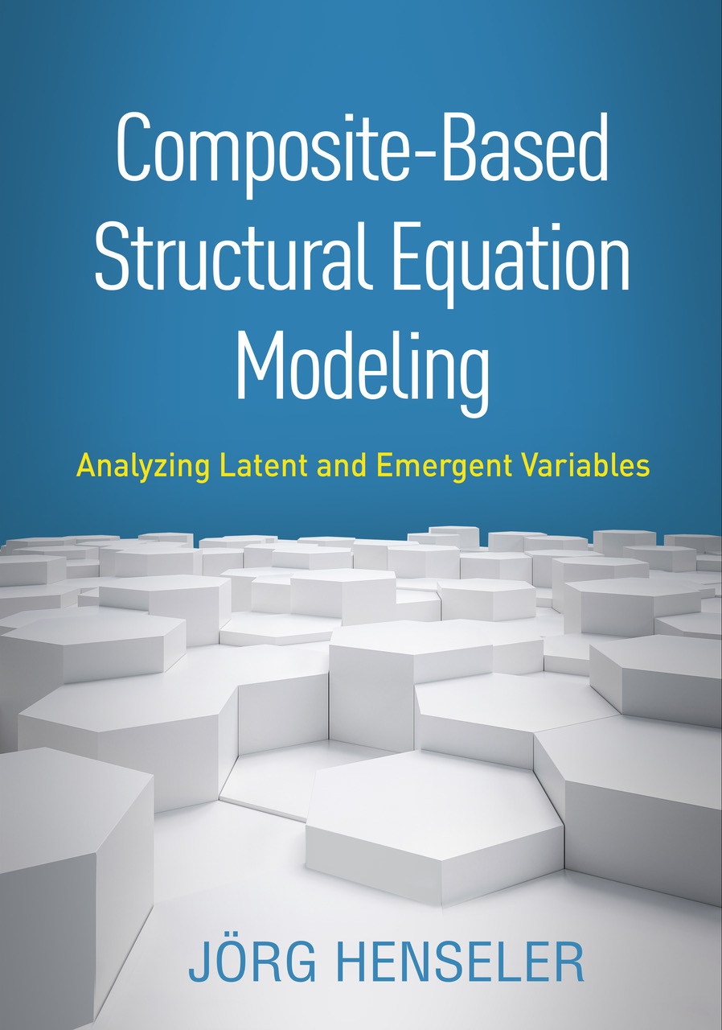
Composite-Based SEM
Chapter 5: Model Estimation

Slide 2
Topics
Estimating composite models
Sum Scores
Partial least squares path modeling (PLS)
Generalized canonical correlation analysis (GCCA)
Generalized structured component analysis (GSCA)
Modifications for factor models
Sum scores with correction for attenuation
Consistent PLS (PLSc)
Fitting functions

Slide 4
Stand-Alone Constructions
Three steps:
Determine weights
Equal weights (leading to sum scores)
Other predefined weights (e.g., based on expert judgment)
Optimized weights (e.g., principal component analysis)
Calculate construct scores:
Calculate path coefficients based on construct score correlations.

Slide 5
PLS Path Modeling and Selected Extensions

Slide 6
What GSCA Actually Does

Slide 7
Correction for Attenuation
The correlation between two latent variables equals the correlation between their construct scores divided by the geometric mean of their scores‘ reliabilities:

Slide 8
Bibliography
Cantaluppi, G., & Boari, G. (2016). A partial least squares algorithm handling ordinal variables. In H. Abdi, V. Esposito Vinzi, G. Russolillo, G. Saporta, & L. Trinchera (Eds.), The Multiple Facets of Partial Least Squares and Related Methods. Cham, Switzerland: Springer, pp. 295–306.
Dijkstra, T. K., & Henseler, J. (2015a). Consistent and asymptotically normal PLS estimators for linear structural equations. Computational Statistics & Data Analysis, 81 (1), 10–23.
Dijkstra, T. K., & Henseler, J. (2015b). Consistent partial least squares path modeling. MIS Quarterly, 39 (2), 297–316.
Henseler, J. (2020). Composite-Based Structural Equation Modeling: Analyzing Latent and Emergent Variables, New York: Guilford Press.
Schamberger, T., Schuberth, F., Henseler, J., & Dijkstra, T. K. (2020). Robust partial least squares path modeling. Behaviormetrika, 47(1), 307–334.
Schuberth, F., Henseler, J., & Dijkstra, T. K. (2018b). Partial least squares path modeling using ordinal categorical indicators. Quality & Quantity, 52(1), 9–35.

