Slide 1
Composite-Based SEM
Chapter 1: Introduction

Slide 2
Topics
The nature of structural equation modeling
What is composite-based SEM?
For which purpose should one use composite-based SEM?

Slide 3
SEM Defined
Structural equation modeling (SEM) is a collection of statistical analyses “that allow a set of relationships between one or more independent variables (IVs), either continuous or discrete, and one or more dependent variables (DVs), either continuous or discrete, to be examined” (Ullman & Bentler, 2003, p. 607).
SEM is a “second generation of multivariate analysis” (Fornell, 1982).

Slide 4
Family Tree of SEM

Slide 5
SEM‘s Core Task: Theory Testing

Slide 6
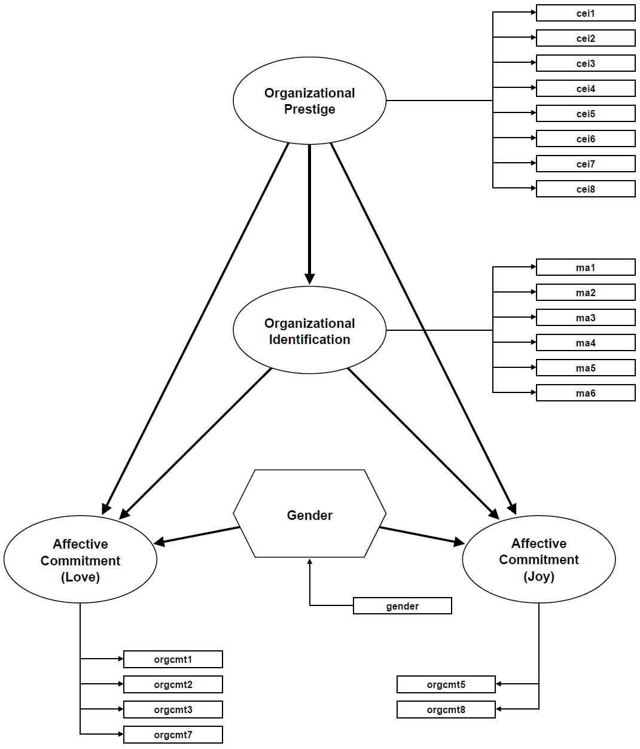
Example

Slide 7
A Typology of SEM Techniques

Slide 8
Composite-Based SEM
Definition of composite-based SEM:
Composite-based SEM are those SEM techniques that involve composites in the estimation phase (Henseler, 2020, p. 11).
This means, composite-based SEM comprises Types 1 to 6 of the typology.

Slide 9
Composite-Based SEM Supports Five Types of Research Endeavors
Confirmatory research
Testing theories (substantial and auxiliary ones)
Explanatory research
Explaining dependent variables
Exploratory research
Providing suggestions for explanations
Predictive research
Determining values for new individual cases
Descriptive research
Reporting variable levels

Slide 10
Bibliography
Fornell, C. (Ed.). (1982). A Second Generation of Multivariate Analysis: Measurement and Evaluation. New York: Praeger.
Henseler, J. (2020). Composite-Based Structural Equation Modeling: Analyzing Latent and Emergent Variables, New York: Guilford Press.
Ullman, J. B., & Bentler, P.M. (2003). Structural equation modeling. In I. B.Weiner, J. A. Schinka, & W. F. Velicer (Eds.), Handbook of Psychology: Research Methods in Psychology (Vol. II, pp. 607–634). Hoboken, NJ: Wiley.

